Slide 1

Stroke prediction model

Slide 2
Table of Contents
1
2
3
4
Problem
Data
Algorithms
Results
5
Conclusions

Slide 3

Problem
Stroke has become one of our century’s most leading diseases. Around 1 in every 4 adults over the age of 25 will have a stroke in their lifetime worldwide. Thus, having a model that predicts the stroke incident before it happens can lead to many crucial benefits:
reducing the number of fatalities annually
relieve the burden on the medical sector.
Notes:
Reference: https://www.world-stroke.org/world-stroke-day-campaign/why-stroke-matters/learn-about-stroke

Slide 4
Data
What is the dataset and how to obtain it
It is a structured (.csv file) stroke dataset that's collected from 43401 patients each with given information about 10 features and their result of whether or not they suffer from a stroke. A stroke is an incident that happens when the brains's blood vessels become narrowed or blocked. subsecuently, the blood cannot travel easily to the brain. Thus, the brain stops functioning due to suffering from stroke and can mostly lead to death.
Highly imbalanced
42606: non-stroke
758: stroke
Features
id, gender, age, hypertension, haert disease, ever married, work type, residence , average glucose, bmi, smoking status
Prediction target value
My model will predict whether this entry/case/patient is most likely to be diagnosed with stroke or not. Thus, my model will produce either yes/no , 0/1 classes which is a classification problem.

Slide 5
Algorithms
1
Random forest
2
Logestic regression
4
Oversampled random forest
5
Oversampled Logestic regression

Slide 6
Project breakdown
Data preprocessing
Oversampled models
Models
EDA
Oversampling data
1
2
3
4
5

Slide 7
Data preprocessing
1
Missing values
2
Redundent & inconsistent values
3
Standarization
4
Dummy variables
5
One-hot encoding
6
Drop unimportant values or features
Bmi (median)
Smoking_status (mode)
No redundency
No inconsistency (Age)
Logestic regression
To remove all categorical variables
Binary categories to 0,1
Id
Other gender

Slide 8
EDA
heatmap
countplot
Target classes
Distribution
To observe the relationship between features and features with target
Work_type
Pie chart
Bmi (skewed)

Slide 9

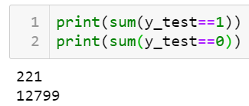



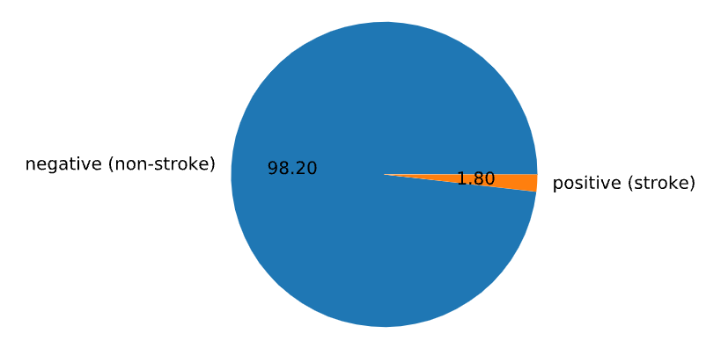
Non-oversampled results
Random forest:
Logestic regression:

Slide 10






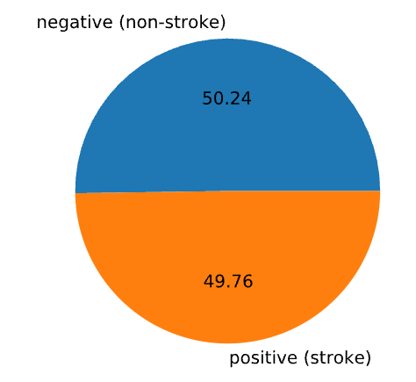
Oversampled results
Random forest:
Logestic regression:

Slide 11
Conclusion
Accuracy can be either deceptive or excellent indicator based on how balanced is the data.
Oversampling techniques make a huge improvement on the models’ performance
This is a leading factor in the improvement of models’ performance
accuracy
Oversampling methods
Data preprocessing

